Slide 1
Wireless Links
Lecture 24 (Wireless 1)
Slides credit: CS168@UC Berkeley
Notes:
Others: Andrea Goldsmith, Neal Patwari, Kyle Jamieson
Slides template credit: Josh Hug, Lisa Yan

Slide 2
Why is Wireless Different?
Why is Wireless Different?
Shared Medium
Attenuation
Changing Environments
Collision Detection
Lecture 24, Spring 2026

Slide 3
Wireless Signals
Wireless signals are waves that propagate in all directions.
Analogy: Ripples in a pond.
Waves interact with each other, and with the environment.
Differences mostly affect Layer 1 (Physical) and Layer 2 (Link).
Wireless is fundamentally a shared medium. (Wired is not.)
Wireless signals attenuate significantly with distance. (Wired signals do not.)
Wireless environments can change rapidly. (Wired environments do not.)
Wireless packet collisions are hard to detect. (Wired packet collisions are not.)
A
B
Notes:
Wireless signals are not packets of data floating in space.

Slide 4
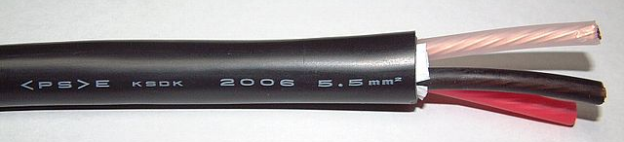
Difference: Wired vs. Wireless Links
Wired links:
Point-to-point (private) by default.
Creating multi-point buses requires work.
Fairly easy to shield from external interference.
Uses electrical signals to transmit data.
Wireless links:
Broadcast (shared) by default.
Creating point-to-point private links requires work.
Fairly hard to shield from external interference.
Modulate electromagnetic fields to transmit data.
Notes:
https://commons.wikimedia.org/wiki/File:600V_CV_5.5sqmm.jpg

Slide 5
Encoding Data Over Wireless Links
Wired link: Encode bits as electrical signals.
High voltage = 1.
Low voltage = 0.
Wireless link:
Draw the bits as a wave?
Problem: Resulting wave is low-frequency, and hard to transmit.
0 0 1 1 0 0 0 0 0 1 0 1 0 1 1 1 1 0 0 0 0

Slide 6
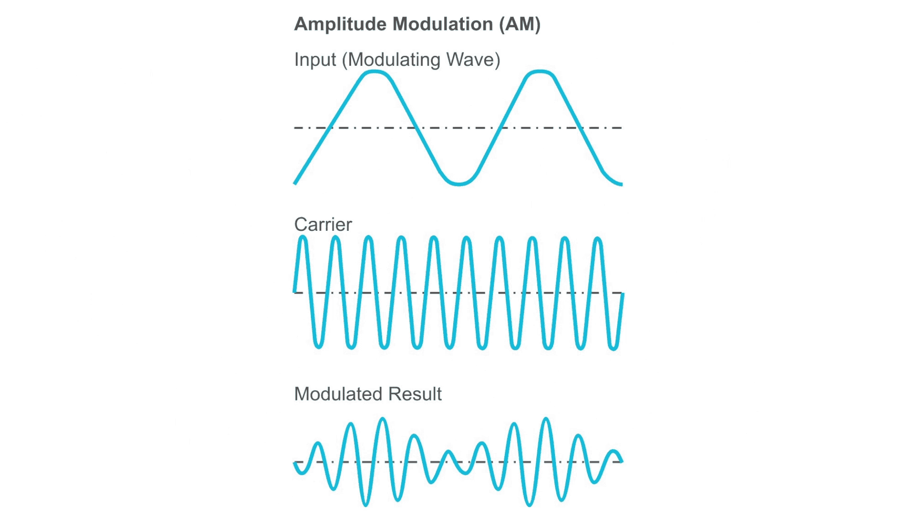
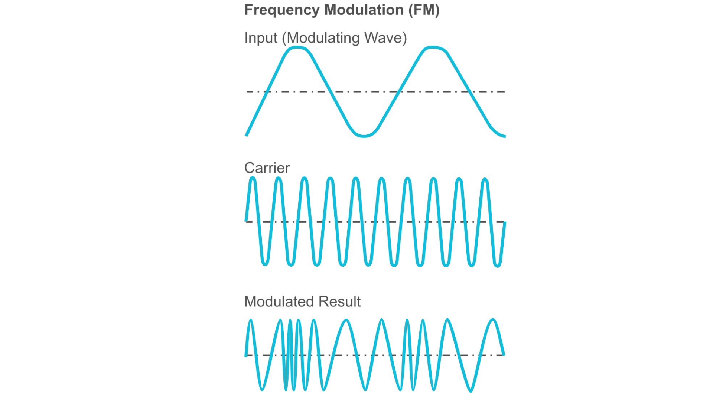
Encoding Data Over Wireless Links – Modulation
Modulation: Impose our data signal on top of a carrier signal.
Carrier signal: A high-frequency, constant wave that contains no information.
The combined wave is easy to transmit, and contains our data!
Original signal
+ Carrier signal
= Modulated signal
Amplitude Modulation (AM):
1 = Taller wave.
0 = Shorter wave.
Frequency Modulation (FM):
1 = Oscillate fast.
0 = Oscillate slow.
Other modulation strategies exist.

Slide 7
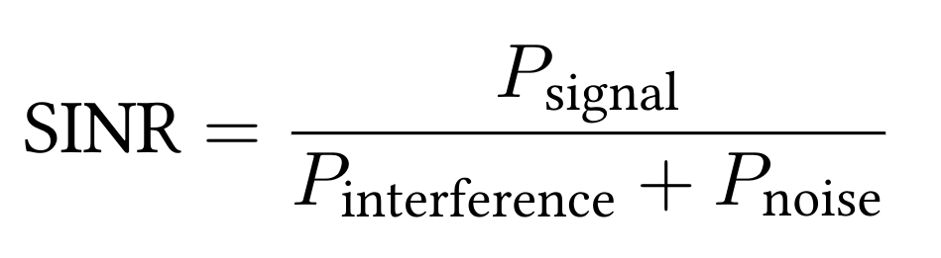
Measuring Noise and Interference – SINR
Shared medium → other signals can corrupt our data!
Noise: Background, ambient signals.
Interference: Another transmitter sending signals.
SINR (Signal to Interference and Noise Ratio) lets us measure connection quality:
Ratio of power to noise+interference at the the receiver.
Higher SINR is better.
If there's more noise+interference, the signal must be stronger.
If signal is weak, can employ coding gain (error-correcting codes).

Slide 8
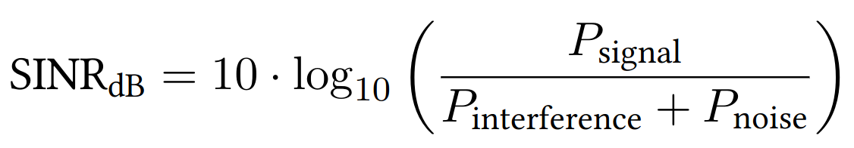
Measuring Noise and Interference – SINR
SINR is dimensionless (it's a ratio).
Decibels let us measure ratios on a logarithmic scale.
Ratio is 10 times greater = increase of 10 dB.
Ratio | Ratio in dB
1 | 0 dB
10 | 10 dB
100 | 20 dB
1000 | 30 dB
10000 | 40 dB
SINR formula.
SINR (measured in dB).

Slide 9
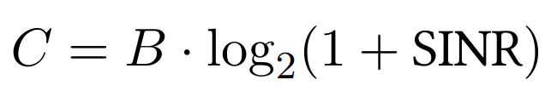
Measuring Noise and Interference – Noisy Channel Shannon Capacity
Shannon capacity: Theoretical limit of how much data can be sent on a noisy channel.
How much data can be sent? (bits/sec)
Bandwidth of channel (range of frequencies we can use).
Ratio of signal power to noise+interference.
Higher bandwidth = can send more data.
SINR increases = can send more data.
Stronger signal, or less noise+interference.
Example: The plain old telephone system:
B = 3000 Hz. (Telephones understand frequencies between 300 Hz and 3300 Hz.)
SINR = 100. (20 dB signal-to-noise ratio.)
C = 3000 · log2(1 + 100) ≈ 20000 = 20 kbps.
Notes:
Bandwidth here is a range of frequencies which is different from how we’ve been using it. It’s the EE bandwidth.

Slide 10
Difference: Wireless Signals Attenuate
Why is Wireless Different?
Shared Medium
Attenuation
Changing Environments
Collision Detection
Lecture 24, Spring 2026

Slide 11
Difference: Attenuation
Wireless signals attenuate – they get much weaker over longer distances.
Our design must account for attenuation.
Wired signals also attenuate, but effect is far smaller.
Trade-off:
Maximize performance: Accuracy, speed, range.
Minimize resource use: Power, use less of the frequency spectrum (costs money).
Trade-off: Better signal requires more resources.

Slide 12
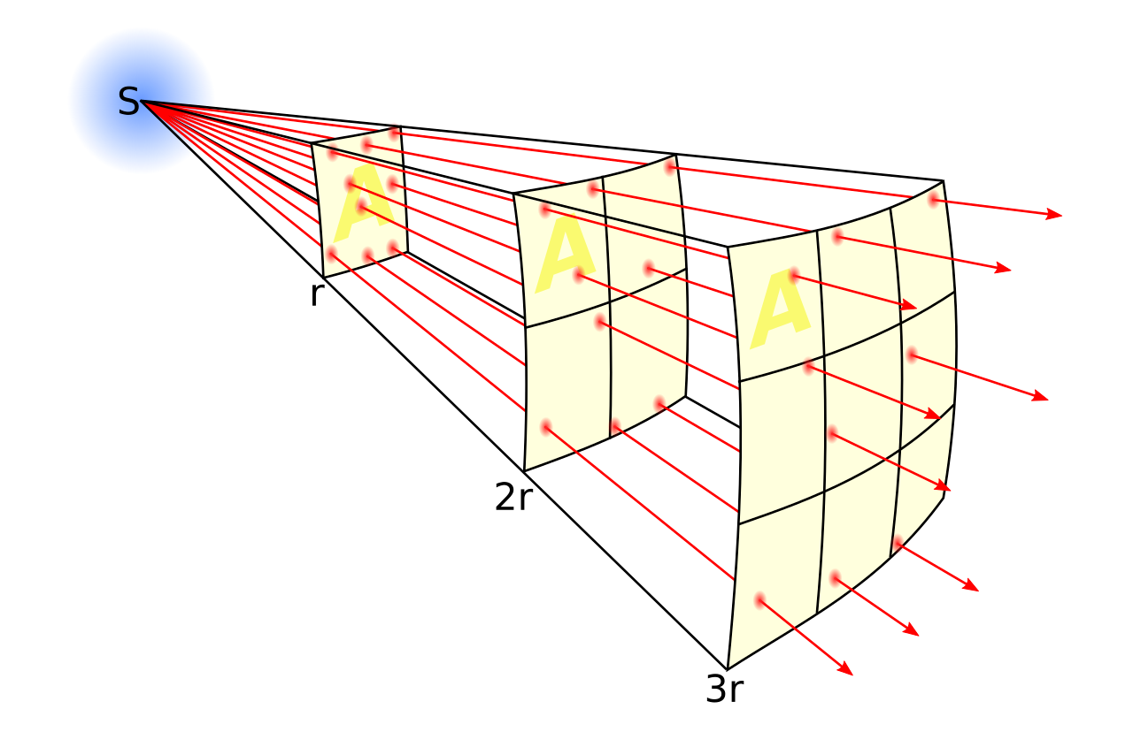
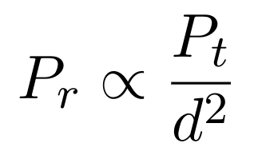
Measuring Attenuation – Free-Space Model
Free-space model (aka line-of-sight model):
Transmitter and receiver exist in empty space.
No obstacles, not even Earth's surface.
In this model, the inverse square law applies.
10 times as far = signal is 100 times weaker.
k times as far = signal is k² times weaker.
Signal Strength
Distance
"is proportional to"
Transmitter power
d = distance between transmitter and receiver
Intuition: Signal propagates out like a sphere.
Signal power is spread over surface of sphere. Surface area of sphere = 4πr².
Receiver power
Notes:
https://commons.wikimedia.org/wiki/File:Inverse_square_law.svg

Slide 13
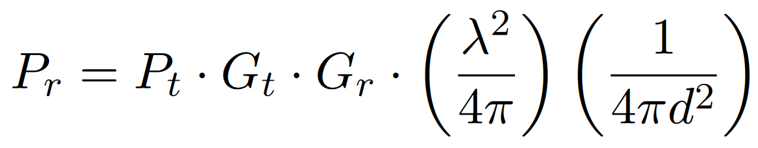
Measuring Attenuation – Friis Equation
The Friis equation accounts for:
Gain of the transmitter and receiver antennas.
Aperture (area) of the receiver antenna. Proof omitted.
Intuition: Larger antenna can capture more signal.
Distance between antennas (inverse-square law).
Aperture of receiver antenna
Distance (inverse square law)
Receiver power
Transmitter power
Gains of antennas
Notes:
D here is distance not diameter
Longer wavelengths = larger effective aperture

Slide 14
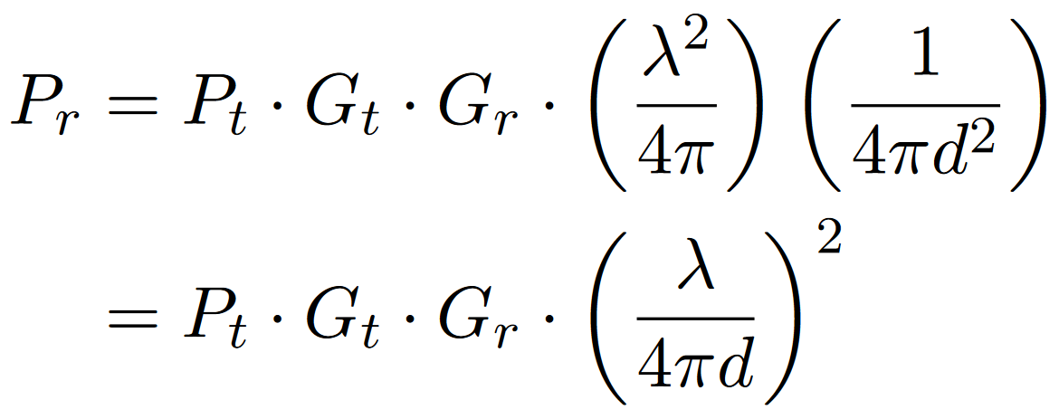
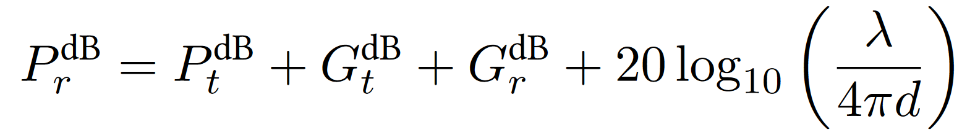
Measuring Attenuation – Friis Equation, Rewritten
The equation is sometimes written like this:
Or in terms of decibels (logarithmic scale):

Slide 15
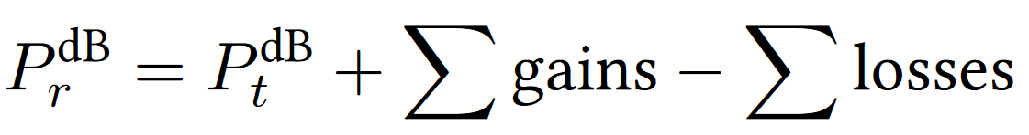
Measuring Attenuation – Link Budget
How do we know if the link will actually work?
Compute a link budget: Add all gains, subtract all losses.
Compare:
Signal power at receiver.
Receiver sensitivity (minimum signal the receiver can hear).
If link budget is positive: Pr > Sensitivity. Link works!
If link budget is negative: Pr < Sensitivity. Link doesn't work!
Link margin is difference between receiver signal and sensitivity.
Bigger link margin = more robust signal.

Slide 16
Measuring Attenuation – Link Budget
Example of computing link budget:
Signal travels 10km: –120 dB
Antenna: +25 dB
Antenna: +25 dB
Cable: –2.21 dB
Cable: –2.21 dB
Cable: –0.44 dB
Cable: –0.44 dB
Transmitted Signal: +10 dBm
Transmitter
Receiver
Received Signal: –65.5 dBm
Sensitivity: –80 dBm
Link margin = 14.5 dBm > 0. Our connection works!
Note: dBm = Power relative to 1 milliwatt.
Notes:
0 dBm = 1 mW
10 dBm = 10 mW
20 dBm = 100 mW
30 dBm = 1 W
-10 dBm = 0.1 mW
-20 dBm = 0.01 mW
-65.5 = 0.0000002818 mW
Adding dB is like multiplying by a ratio, so this might seem odd but is ok :)

Slide 17
Difference: Changing Environments
Why is Wireless Different?
Shared Medium
Attenuation
Changing Environments
Collision Detection
Lecture 24, Spring 2026

Slide 18
Difference: Environments Change
Wireless environments change rapidly.
Devices move around.
Signals reflect and refract off physical obstacles (e.g. buildings, Earth's surface).
Signal Strength
Signal Strength
Distance
Distance
Free-space model: Signal weakens over distance.
After accounting for obstacles: Signal strength fluctuates!

Slide 19
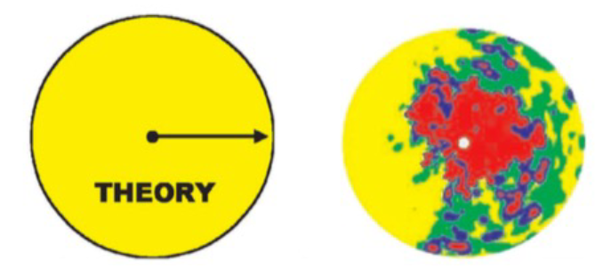
Path Loss is Messy
Wireless propagation is messy.
In theory: Signal propagates in all directions.
In real life: Signal strength depends on environment.
Color = strength of signal.
Notes:
Credit: Neal Patwari

Slide 20
Characteristics of Path Loss
3 characteristics affect signal strength:
Free-space loss:
– Due to inverse square law. – Fluctuates very slowly.
Signal Strength
Distance
Signal Strength
Shadowing:
– Due to obstructions. – Fluctuates quickly.
Signal Strength
+
Distance
Multipath fading:
– Due to signal colliding with itself. – Fluctuates very quickly.
Distance
Signal Strength
Distance

Slide 21
Modeling Path Loss – Two-Ray Model
Two-ray model assumes the signal waves travel along two paths:
Line-of-sight path: Wave arrives with no obstacles.
Ground-bounce path: Wave reflects off the Earth's surface.
Assuming sender and receiver are far enough:
Two waves arrive phase-shifted at the receiver, causing destructive interference.
Signal strength ∝ 1/d⁴. Drops off much faster than inverse-square law!
Line-of-sight path
Signal arrives with phase offset...
...canceling each other out!
Signal
Signal
=
Ground bounce path
Time
Time
Earth's surface
Sender tower
Receiver tower

Slide 22
Modeling Path Loss – Two-Ray Model
If sender and receiver are far enough:
Waves arrive phase-shifted at the receiver, causing destructive interference.
Signal strength ∝ 1/d⁴. Drops off much faster than inverse-square law!
Signal Strength
Signal Strength
Distance
Distance
Free-space model:
– Signal strength ∝ 1/d². – Idealized, no obstacles.
Two-ray model:
– Signal strength ∝ 1/d⁴. – Signal bounces off ground. Causes destructive interference.

Slide 23
Modeling Path Loss – General Ray Tracing Models
General ray tracing models account for other obstacles.
Signals reflect, scatter, and diffract.
Most signals arriving at receiver are reflections.
Run simulations in software. Requires information about environment.
Obstacle
Obstacle
Obstacle
Earth's surface
Sender
Receiver

Slide 24
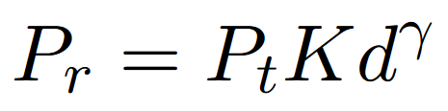
Modeling Path Loss – General Ray Tracing Models
Free-space model: Signal strength ∝ 1/d².
Two-ray model: Signal strength ∝ 1/d⁴.
General ray tracing model:
Receiver power
Transmitter power
Distance
K and γ are empirically determined by the model.
Signal dominated by reflections.
Exponent γ is determined empirically. Usually between –2 and –8.

Slide 25
Difference: Collision Detection
Why is Wireless Different?
Shared Medium
Attenuation
Changing Environments
Collision Detection
Lecture 24, Spring 2026

Slide 26
Difference: Collision Detection
Wired collisions are easy to detect.
On a point-to-point link, collisions might not happen at all.
There's just one signal on the wire to sense.
Wireless collisions are much harder to detect.
There's a spatial aspect to collisions.
Signals can collide in one place, but not another place.
A
B
No collision here!
Signals collide here.
No collision here!

Slide 27
Recall: Multiple Access Protocols
Recall: Many ways for devices to share a link.
Let's start with CSMA: Listen, and transmit when it's quiet.
Then we'll design some protocols for wireless networks.
Multiple Access Protocols
Multiplexing
Taking Turns
Random Access
Frequency
Time
Polling
Tokens
ALOHA
CSMA
CSMA/CD

Slide 28
CSMA in Wireless Networks
If pairs are well-separated, no problem!
Goal: A→B and C→D.
A transmits to B.
C transmits to D at the same time.
No collisions!
Notice: Signals propagate in all directions (not just toward the destination).
Arrows are just drawn for convenience.
A
B
C
D

Slide 29
CSMA in Wireless Networks
If pairs are in range of each other, no problem!
Goal: A→B and C→D.
A transmits to B.
C detects transmission. Must wait to transmit to D.
No collisions! A–B and C–D take turns.
A is quiet now. My turn!
I hear A transmitting!
I'll wait for A to finish.
A
B
C
D

Slide 30
CSMA in Wireless Networks – Hidden Terminal Problem
Hidden terminal problem:
Goal: A→B and C→B.
A senses quiet, and starts transmitting.
C senses quiet, and starts transmitting.
Collision at B!
Problem: A and C are out-of-range. They can't detect each other sending.
All is quiet. Time to send!
All is quiet. Time to send!
???
A
B
C

Slide 31
CSMA in Wireless Networks – Exposed Terminal Problem
Exposed terminal problem:
Goal: B→A and C→D.
B senses quiet, and starts transmitting.
C senses a collision and doesn't send.
Notice: We could have actually sent simultaneously.
Some areas have collision, but we don't care. No collisions at the receivers.
All is quiet. Time to send!
I hear B.
I'll be quiet.
A
B
C
D
This would have been okay! But C didn't send.

Slide 32
MACA (Multiple Access with Collision Avoidance)
Key problem: CSMA detects collisions at the sender.
But we only care about collisions at the receiver.
Solution: Let's have the receiver announce if it detects collisions.
New protocol for shared medium: MACA (Multiple Access with Collision Avoidance).
Note: No carrier sense.

Slide 33
MACA (Multiple Access with Collision Avoidance)
To communicate over MACA:
Sender transmits Request to Send (RTS) with length of data.
Receiver transmits a Clear to Send (CTS) with length of data.
This tells sender that it's safe to send. No collisions at receiver.
This tells everyone in receiver's range to be quiet.
A
B
RTS: "I want to send 1 MB."
CTS: "If you hear this, shut up. I need to receive 1 MB."
A sends 1 MB.

Slide 34
MACA (Multiple Access with Collision Avoidance) – Solving Hidden Terminal Problem
MACA solves the hidden terminal problem.
Goal: A→B, C→B.
B now tells everyone in its range to be quiet, using the CTS.
C won't send anymore. Collision avoided!
B told me to be quiet. I won't send.
A
B
C
RTS: "I want to send 1 MB."
CTS: "If you hear this, shut up. I need to receive 1 MB."
A sends 1 MB.
C would have sent, but MACA saved the day!

Slide 35
MACA (Multiple Access with Collision Avoidance) – Rules
If you hear a CTS, be quiet until the data is sent.
CTS contains length of data.
You can use data length to estimate how long you need to wait.
If you hear an RTS, be quiet for one time slot.
Give the receiver time to send the CTS.
If you don't be quiet, you might clobber out the CTS.
After waiting:
If you hear the CTS: You're in receiver range. Be quiet.
If you don't hear the CTS: You're not in receiver range. You can send again.

Slide 36
MACA (Multiple Access with Collision Avoidance) – Solving Exposed Terminal Problem
MACA solves the exposed terminal problem, under certain assumptions.
Goal: B→A and C→D.
C hears the RTS and defers for one time slot.
C doesn't hear the CTS, so it's out-of-range of the other receiver, and can send.
I hear an RTS. I'll be quiet for 1 time slot to avoid clobbering the CTS.
I didn't hear the CTS. I'm not in receiver range. I can send data!
A
B
C
D
RTS: "I want to send 1 MB."
CTS: "If you hear this, shut up. I'm receiving 1 MB."
C quiet at this time.
C can send here too! (After its own RTS/CTS.)
B sends 1 MB.

Slide 37
MACA (Multiple Access with Collision Avoidance) – Solving Exposed Terminal Problem
MACA solves the exposed terminal problem, under one assumption.
Assumes that C can hear the CTS from D over B's data.
Key problem: MACA requires the sender to listen (for the CTS).
Contrast with CSMA: Sender just sends.
Did I hear CTS from D, or data from B?
A
B
C
D
RTS: "I want to send 1 MB."
CTS: "If you hear this, shut up. I'm receiving 1 MB."
C quiet at this time.
RTS: "I want to send 1 MB."
CTS from D.
B sends 1 MB.

Slide 38
MACA (Multiple Access with Collision Avoidance) – Collisions
If we send RTS, but don't hear CTS, that means there was a collision!
Apply exponential backoff and wait up to twice as long before sending another RTS.
Each device maintains a CW (Contention Window) value.
Pick a random number in [0, CW]. Wait that long before re-sending RTS.
Rules for adjusting CW:
Minimum value: CW = 2.
Maximum value: CW = 64.
On successful RTS/CTS: Set CW ← 2.
On failed RTS/CTS: Set CW ← 2 × CW, clamped at 64.

Slide 39

Chapter 7 outline
Introduction
Wireless
Wireless links and network characteristics
CDMA: code division multiple access
WiFi: 802.11 wireless LANs
Bluetooth

Slide 40
Review: FDMA and TDMA
Frequency
Frequency
User n
…
User 1
…
User 2
User 2
User n
User 1
Time
Time
First generation (1G) systems use Frequency Division Multiple Access (FDMA)
Most of second generation (2G) systems use Time Division Multiple Access (TDMA)

Slide 41
Code Division Multiple Access (CDMA)
IMPORTANT
Frequency
User 1
.
User 2
.
.
User n
Time
Code
Users share bandwidth by using code sequences that are orthogonal to each other
Some 2G and most 3G systems use CDMA

Slide 42

Code Division Multiple Access (CDMA)
IMPORTANT
unique “code” assigned to each user; i.e., code set partitioning
all users share same frequency, but each user has own chipping sequence (i.e., code) to encode data
allows multiple users to “coexist” and transmit simultaneously with minimal interference (if codes are “orthogonal”)
analogy: people speaking different languages in the same roo do not interfere with each other
encoding: scalar-vector product: (original data) $∗$ (chipping sequence)
d $∗$ (x₁, x₂, … , x_{n}) = (d*x₁, d*x₂, …, d*x_{n}), where d = +1 or -1.
decoding: vector-vector inner-product: (encoded data) $⋅$ (chipping sequence)
Defined as sum of elementwise product:
(x₁, x₂, … , x_{n}) $⋅$ (y₁, y₂, … , y_{n}) = (x₁*y₁+x₂*y₂+…+x_{n}*y_{n})

Slide 43
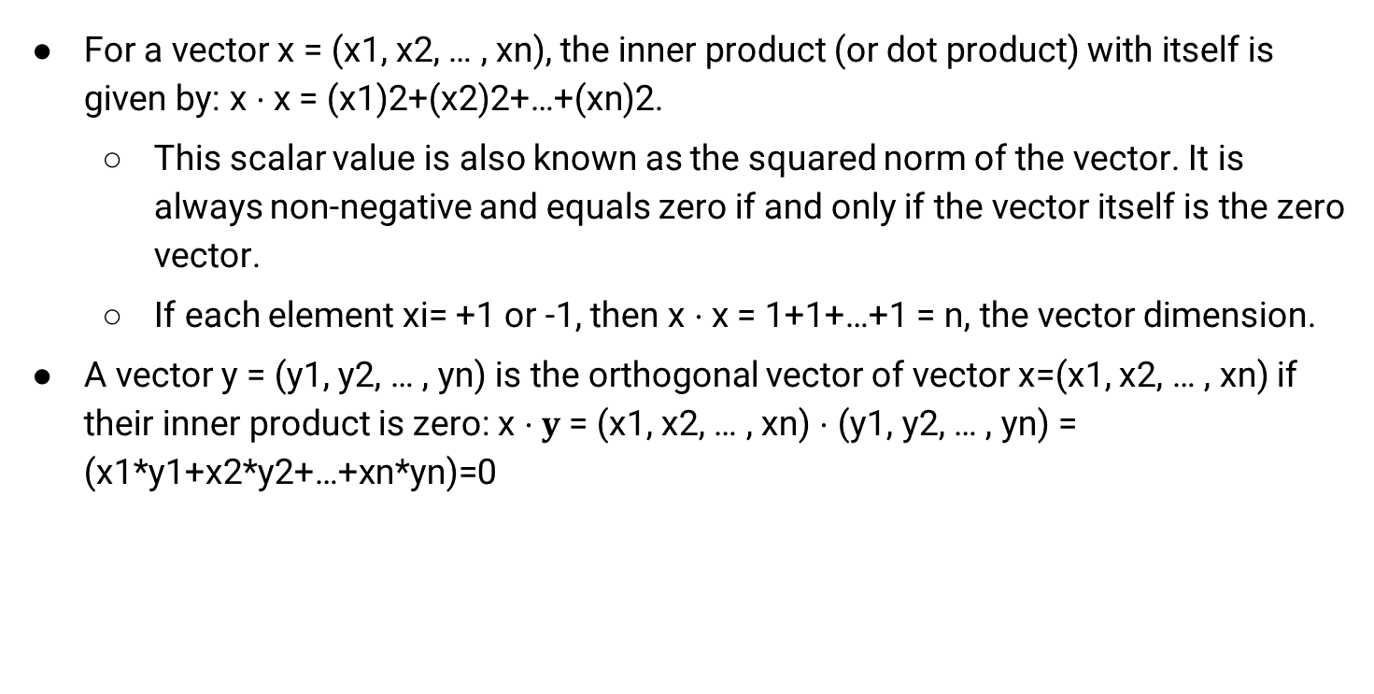
Vector-Vector Inner-Product, Orthogonal Vector
For a vector x = (x1, x2, … , xn), the inner product (or dot product) with itself is given by: x $⋅$x = (x1)2+(x2)2+…+(xn)2.
This scalar value is also known as the squared norm of the vector. It is always non-negative and equals zero if and only if the vector itself is the zero vector.
If each element xi= +1 or -1, then x $⋅$x = 1+1+…+1 = n, the vector dimension.
A vector y = (y1, y2, … , yn) is the orthogonal vector of vector x=(x1, x2, … , xn) if their inner product is zero: x $⋅y$= (x1, x2, … , xn) $⋅$ (y1, y2, … , yn) = (x1*y1+x2*y2+…+xn*yn)=0
Notes:
The square root of this value gives the Euclidean norm (or length) of the vector:∥v∥=v⋅v∥v∥=v⋅v​

Slide 44
Direct-Sequence Spread Spectrum CDMA
IMPORTANT
+1
+1
+1
+1
-1
-1
-1
Chipping sequence (Code): (+1,+1,+1,-1,+1,-1,-1,-1)
The 8-bit sequence 1*(+1,+1,+1,-1,+1,-1,-1,-1) encodes data bit 1 (corresponding to application bit 1).
The 8-bit sequence (-1)*(+1,+1,+1,-1,+1,-1,-1,-1) = (-1,-1,-1,1,-1,1,1,1) encodes data bit -1 (corresponding to application bit 0).
Spreading factor = Code length/data bit = 8
10-100 commercial (Min 10 by FCC), 10,000 for military
Two codes are orthogonal to each other, if their inner product equals 0.
Notes:
Signal bandwidth > 10 × data bandwidth
Code sequence synchronization
Z_{i,m}= d_{i}.c_{m}
-1*(1,1,1,-1,1,-1,-1,-1) = (-1,-1,-1,1,-1,1,1,1)
1*(1,1,1,-1,1,-1,-1,-1) = (1,1,1,-1,1,-1,-1,-1)
Correlation between codes ⇒ Interference ⇒ Orthogonal

Slide 45
CDMA encode/decode
IMPORTANT
Encoded data in slot 1:
-1*(+1,+1,+1,-1,+1,-1,-1,-1)
= (-1,-1,-1,+1,-1,+1,+1,+1)
channel output Z_{i,m}
Z_{i,m}= d_{i}.c_{m}
data
bits
d₀ = 1
1
1
1
1
1
d₁ = -1
1
1
1
-
-
-
-
1
-
-
-
1
-
1
1
1
1
1
sender
1
1
slot 1
channel
output
slot 0
channel
output
1
1
1
1
code
1
1
1
-
-
-
1
-
1
-
1
1
-
-
1
-
1
1
1
slot 1
slot 0
M
d_{i} = Σ Z_{i,m}.c_{m}
m=1
receiver
M
received
input
1
1
1
1
1
1
1
1
d₀ = 1
-
-
-
-
1
-
-
-
1
-
1
1
1
1
1
1
d₁ = -1
1
slot 1
channel
output
slot 0
channel
output
1
1
1
1
1
code
1
1
-
-
-
1
-
1
1
1
-
-
-
1
-
1
1
1
slot 1
slot 0
Decoded data in slot 1:
= (1/8)*(-1,-1,-1,1,-1,+1,+1,+1) ⋅ (+1,+1,+1,-1,+1,-1,-1,-1)
= -1

Slide 46
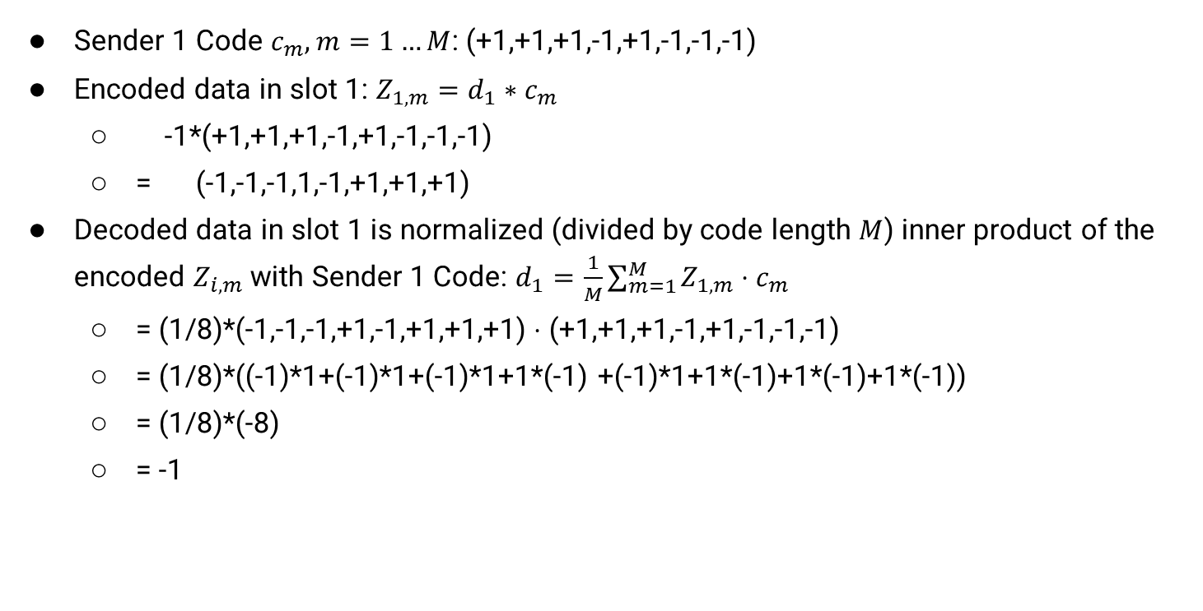
CDMA encode/decode
IMPORTANT
Sender 1 Code $c_{m}, m=1…M$: (+1,+1,+1,-1,+1,-1,-1,-1)
Encoded data in slot 1: $Z_{1,m}=d_{1}∗c_{m}$
-1*(+1,+1,+1,-1,+1,-1,-1,-1)
= (-1,-1,-1,1,-1,+1,+1,+1)
Decoded data in slot 1 is normalized (divided by code length $M$) inner product of the encoded $Z_{i,m}$with Sender 1 Code: $d_{1}=\frac{1}{M}\sum_{m=1}^{M}{Z_{1,m}}⋅c_{m}$
= (1/8)*(-1,-1,-1,+1,-1,+1,+1,+1) $⋅$ (+1,+1,+1,-1,+1,-1,-1,-1)
= (1/8)*((-1)*1+(-1)*1+(-1)*1+1*(-1) +(-1)*1+1*(-1)+1*(-1)+1*(-1))
= (1/8)*(-8)
= -1

Slide 47
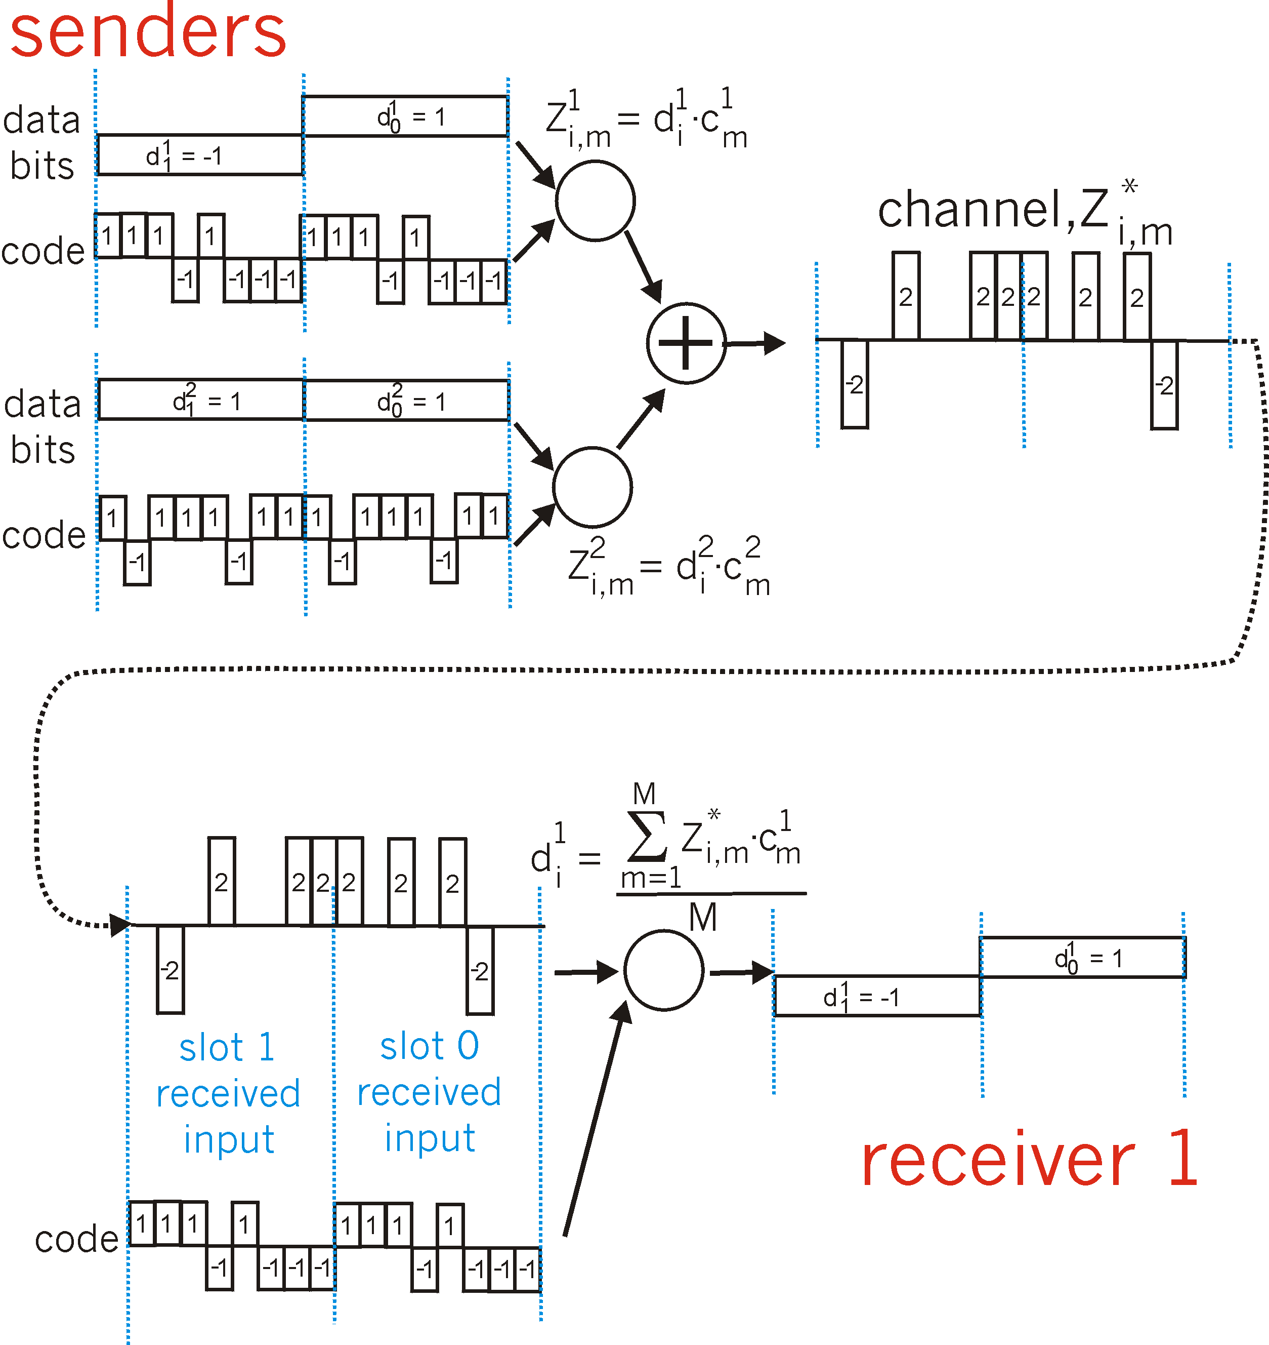
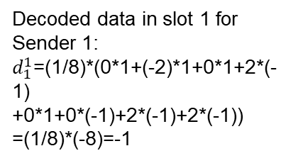
CDMA: two-sender interference
IMPORTANT
channel sums together transmissions by sender 1 and 2
Sender 1
Encoded data in slot 1:
-1*(+1,+1,+1,-1,+1,-1,-1,-1)
+ 1*(+1,-1,+1,+1,+1,-1,+1,+1)
= (0,-2,0,2,0,0,2,2)
Sender 2
using same code as sender 1, receiver recovers sender 1’s original data from summed channel data!
M=8 (# bits)
Decoded data in slot 1 for Sender 1:
$d_{1}^{1}$=(1/8)*(0*1+(-2)*1+0*1+2*(-1)
+0*1+0*(-1)+2*(-1)+2*(-1))
=(1/8)*(-8)=-1
(provided the codes for different
senders are orthogonal)

Slide 48
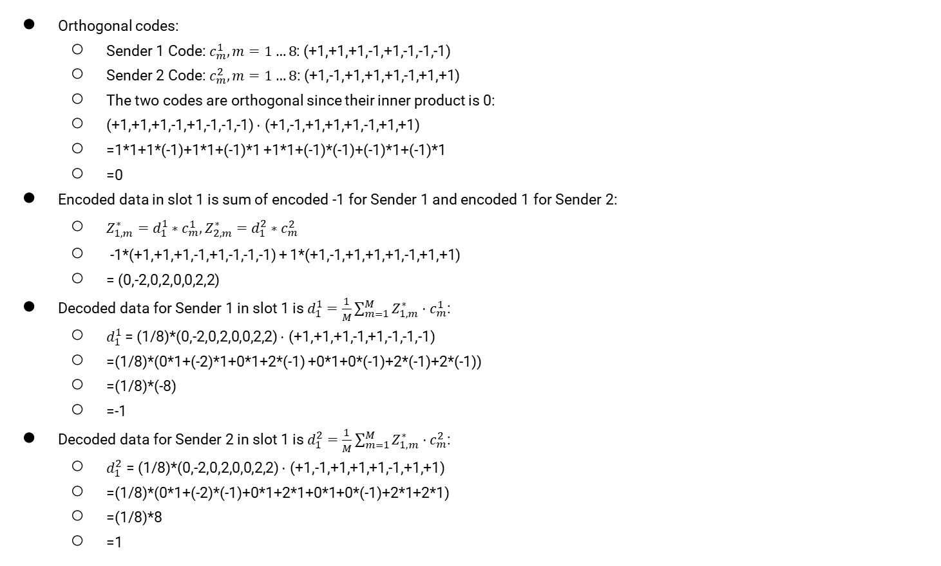
CDMA: two-sender interference
IMPORTANT
Orthogonal codes:
Sender 1 Code: $c_{m}^{1},m=1…8$: (+1,+1,+1,-1,+1,-1,-1,-1)
Sender 2 Code: $c_{m}^{2},m=1…8\text{:}$ (+1,-1,+1,+1,+1,-1,+1,+1)
The two codes are orthogonal since their inner product is 0:
(+1,+1,+1,-1,+1,-1,-1,-1) $⋅$ (+1,-1,+1,+1,+1,-1,+1,+1)
=1*1+1*(-1)+1*1+(-1)*1 +1*1+(-1)*(-1)+(-1)*1+(-1)*1
=0
Encoded data in slot 1 is sum of encoded -1 for Sender 1 and encoded 1 for Sender 2:
$Z_{1,m}^{∗}=d_{1}^{1}∗c_{m}^{1},Z_{2,m}^{∗}=d_{1}^{2}∗c_{m}^{2}$
-1*(+1,+1,+1,-1,+1,-1,-1,-1) + 1*(+1,-1,+1,+1,+1,-1,+1,+1)
= (0,-2,0,2,0,0,2,2)
Decoded data for Sender 1 in slot 1 is $d_{1}^{1}=\frac{1}{M}\sum_{m=1}^{M}{Z_{1,m}^{∗}}⋅c_{m}^{1}$:
$d_{1}^{1}$= (1/8)*(0,-2,0,2,0,0,2,2) $⋅$ (+1,+1,+1,-1,+1,-1,-1,-1)
=(1/8)*(0*1+(-2)*1+0*1+2*(-1) +0*1+0*(-1)+2*(-1)+2*(-1))
=(1/8)*(-8)
=-1
Decoded data for Sender 2 in slot 1 is $d_{1}^{2}=\frac{1}{M}\sum_{m=1}^{M}{Z_{1,m}^{∗}}⋅c_{m}^{2}$:
$d_{1}^{2}$ = (1/8)*(0,-2,0,2,0,0,2,2) $⋅$ (+1,-1,+1,+1,+1,-1,+1,+1)
=(1/8)*(0*1+(-2)*(-1)+0*1+2*1+0*1+0*(-1)+2*1+2*1)
=(1/8)*8
=1

Slide 49
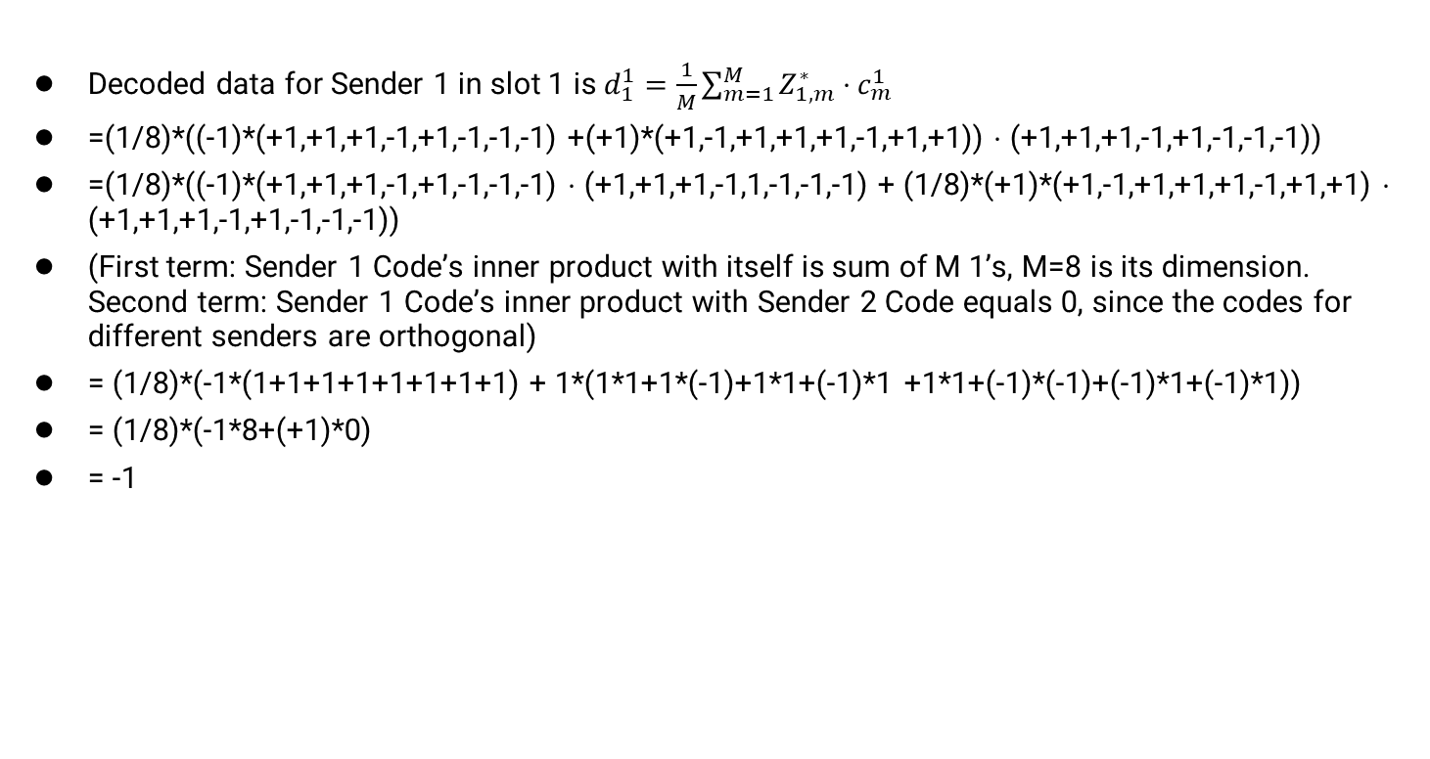
CDMA: two-sender interference: Sender 1
IMPORTANT
Decoded data for Sender 1 in slot 1 is $d_{1}^{1}=\frac{1}{M}\sum_{m=1}^{M}{Z_{1,m}^{∗}}⋅c_{m}^{1}$
=(1/8)*((-1)*(+1,+1,+1,-1,+1,-1,-1,-1) +(+1)*(+1,-1,+1,+1,+1,-1,+1,+1)) $⋅$ (+1,+1,+1,-1,+1,-1,-1,-1))
=(1/8)*((-1)*(+1,+1,+1,-1,+1,-1,-1,-1) $⋅$ (+1,+1,+1,-1,1,-1,-1,-1) + (1/8)*(+1)*(+1,-1,+1,+1,+1,-1,+1,+1) $⋅$ (+1,+1,+1,-1,+1,-1,-1,-1))
(First term: Sender 1 Code’s inner product with itself is sum of M 1’s, M=8 is its dimension. Second term: Sender 1 Code’s inner product with Sender 2 Code equals 0, since the codes for different senders are orthogonal)
= (1/8)*(-1*(1+1+1+1+1+1+1+1) + 1*(1*1+1*(-1)+1*1+(-1)*1 +1*1+(-1)*(-1)+(-1)*1+(-1)*1))
= (1/8)*(-1*8+(+1)*0)
= -1

Slide 50
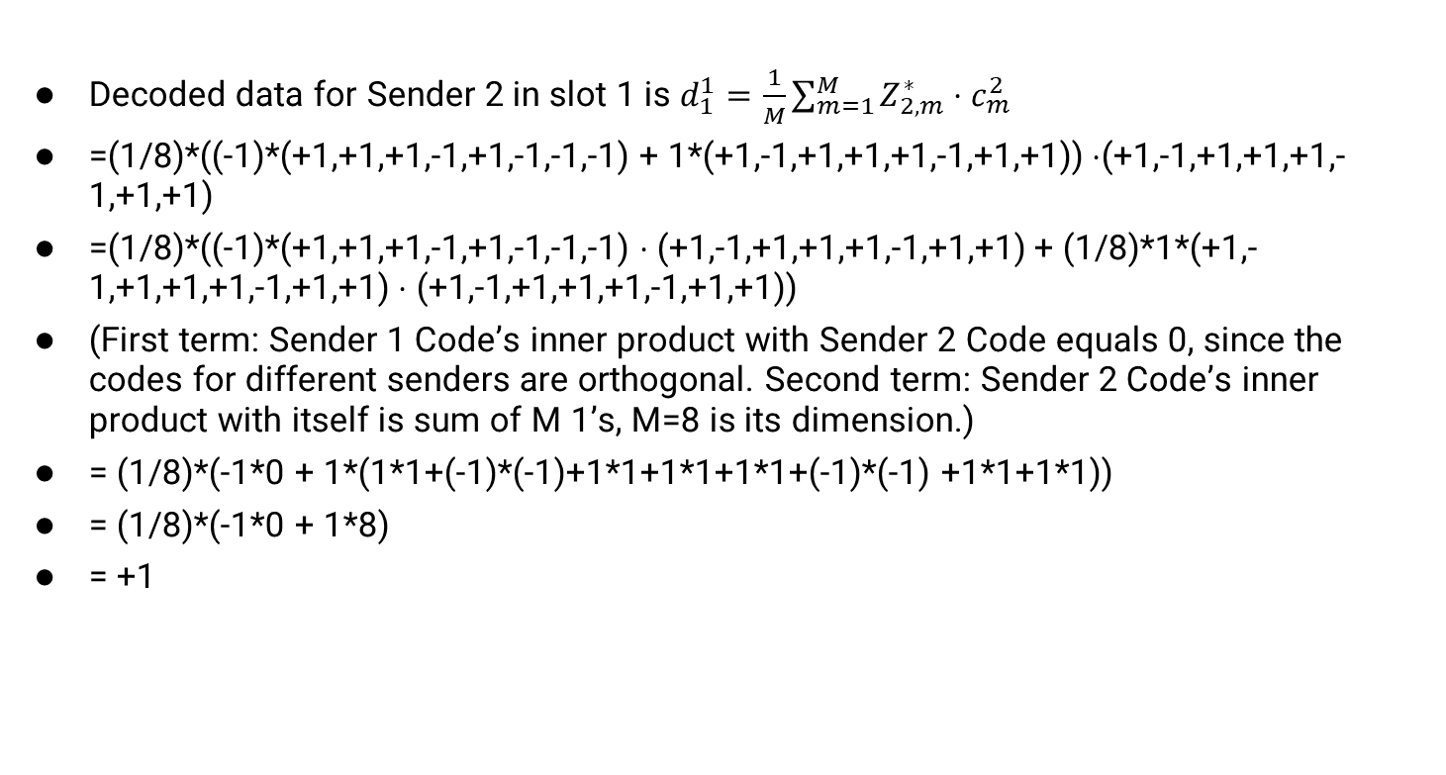
CDMA: two-sender interference: Sender 2
IMPORTANT
Decoded data for Sender 2 in slot 1 is $d_{1}^{1}=\frac{1}{M}\sum_{m=1}^{M}{Z_{2,m}^{∗}}⋅c_{m}^{2}$
=(1/8)*((-1)*(+1,+1,+1,-1,+1,-1,-1,-1) + 1*(+1,-1,+1,+1,+1,-1,+1,+1)) $⋅$(+1,-1,+1,+1,+1,-1,+1,+1)
=(1/8)*((-1)*(+1,+1,+1,-1,+1,-1,-1,-1) $⋅$(+1,-1,+1,+1,+1,-1,+1,+1) + (1/8)*1*(+1,-1,+1,+1,+1,-1,+1,+1) $⋅$ (+1,-1,+1,+1,+1,-1,+1,+1))
(First term: Sender 1 Code’s inner product with Sender 2 Code equals 0, since the codes for different senders are orthogonal. Second term: Sender 2 Code’s inner product with itself is sum of M 1’s, M=8 is its dimension.)
= (1/8)*(-1*0 + 1*(1*1+(-1)*(-1)+1*1+1*1+1*1+(-1)*(-1) +1*1+1*1))
= (1/8)*(-1*0 + 1*8)
= +1

Slide 51
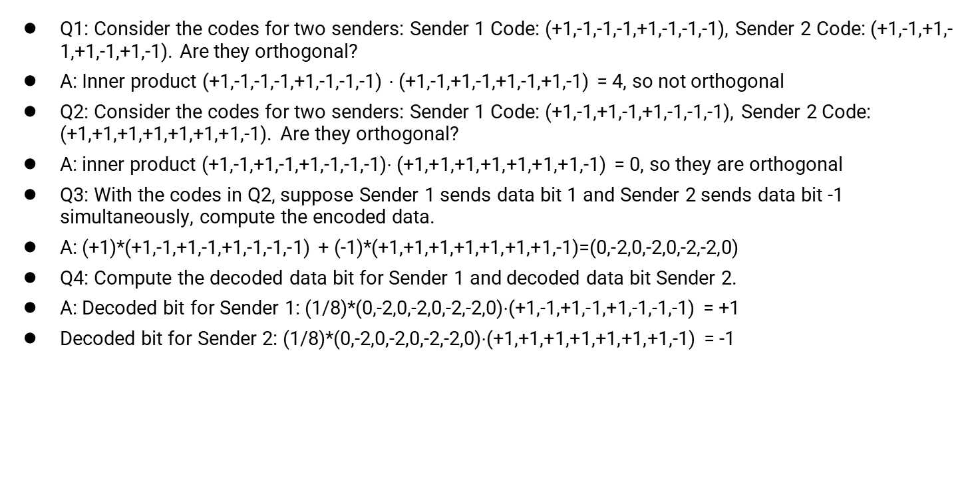
Quiz 1 CDMA
IMPORTANT
Q1: Consider the codes for two senders: Sender 1 Code: (+1,-1,-1,-1,+1,-1,-1,-1), Sender 2 Code: (+1,-1,+1,-1,+1,-1,+1,-1). Are they orthogonal?
A: Inner product (+1,-1,-1,-1,+1,-1,-1,-1) $⋅$(+1,-1,+1,-1,+1,-1,+1,-1) = 4, so not orthogonal
Q2: Consider the codes for two senders: Sender 1 Code: (+1,-1,+1,-1,+1,-1,-1,-1), Sender 2 Code: (+1,+1,+1,+1,+1,+1,+1,-1). Are they orthogonal?
A: inner product (+1,-1,+1,-1,+1,-1,-1,-1)$⋅$(+1,+1,+1,+1,+1,+1,+1,-1) = 0, so they are orthogonal
Q3: With the codes in Q2, suppose Sender 1 sends data bit 1 and Sender 2 sends data bit -1 simultaneously, compute the encoded data.
A: (+1)*(+1,-1,+1,-1,+1,-1,-1,-1) + (-1)*(+1,+1,+1,+1,+1,+1,+1,-1)=(0,-2,0,-2,0,-2,-2,0)
Q4: Compute the decoded data bit for Sender 1 and decoded data bit Sender 2.
A: Decoded bit for Sender 1: (1/8)*(0,-2,0,-2,0,-2,-2,0)$⋅$(+1,-1,+1,-1,+1,-1,-1,-1) = +1
Decoded bit for Sender 2: (1/8)*(0,-2,0,-2,0,-2,-2,0)$⋅$(+1,+1,+1,+1,+1,+1,+1,-1) = -1

Slide 52
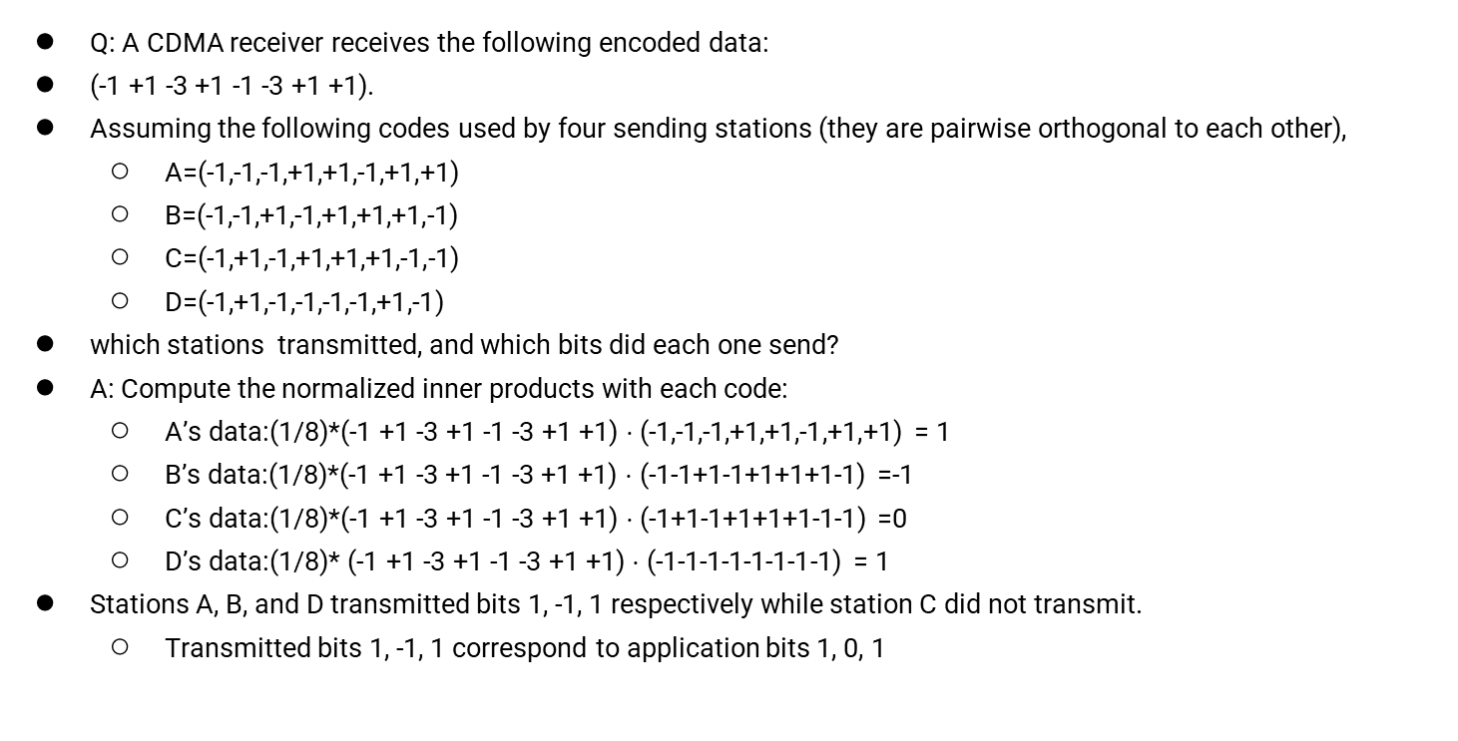
Quiz 2 CDMA
IMPORTANT
Q: A CDMA receiver receives the following encoded data:
(-1 +1 -3 +1 -1 -3 +1 +1).
Assuming the following codes used by four sending stations (they are pairwise orthogonal to each other),
A=(-1,-1,-1,+1,+1,-1,+1,+1)
B=(-1,-1,+1,-1,+1,+1,+1,-1)
C=(-1,+1,-1,+1,+1,+1,-1,-1)
D=(-1,+1,-1,-1,-1,-1,+1,-1)
which stations transmitted, and which bits did each one send?
A: Compute the normalized inner products with each code:
A’s data:(1/8)*(-1 +1 -3 +1 -1 -3 +1 +1) $⋅$ (-1,-1,-1,+1,+1,-1,+1,+1) = 1
B’s data:(1/8)*(-1 +1 -3 +1 -1 -3 +1 +1) $⋅$ (-1-1+1-1+1+1+1-1) =-1
C’s data:(1/8)*(-1 +1 -3 +1 -1 -3 +1 +1) $⋅$ (-1+1-1+1+1+1-1-1) =0
D’s data:(1/8)* (-1 +1 -3 +1 -1 -3 +1 +1) $⋅$ (-1-1-1-1-1-1-1-1) = 1
Stations A, B, and D transmitted bits 1, -1, 1 respectively while station C did not transmit.
Transmitted bits 1, -1, 1 correspond to application bits 1, 0, 1

Slide 53
Summary
Wireless is different!
Shared medium by default
Attenuation due to distance and obstacles
Rapidly shifting environments
Collision detection is different
Use MACA instead of CSMA for collision detection at receivers.
Modulation reference:
https://www.taitradioacademy.com/topic/how-does-modulation-work-1-1/

